Slide 1







Fraud Detection In Mobile Money Transcations Kaggle Dataset- Synthetic Financial datasets generated by: the PaySim mobile money simulator https://www.kaggle.com/ntnu-testimon/paysim1

Slide 2
Gentle Introduction of the topic
Paying for groceries to booking flight tickets to purchasing just a cup of coffee on a mobile app, mobile money transactions are becoming the standard.
In 2019, close to $2 billion in daily transactions
Although mobile banking has simplified banking for the masses, it has given rise to a new era of financial fraud which is now reaching an epidemic proportions
In 2019, 50% of worldwide suspected fraudulent transactions were from mobile devices
(41% - 2018 ,21%-2017)
Few well known incidents
Approx $1.5 million on fraudulent purchases via Apple Pay
Hundreds of PayPal accounts attacked, caused ~ $1 million fraud

Slide 3
Objective
Due to private nature of financial transactions a synthetic dataset generated using the simulator called PaySim
Objective is to use the dataset to construct and validate a model to detect fraudulent mobile money transactions using python language and Google Colab
Business
Relevant business problem with ever evolving challenges
Insights about financial data
Can be applied to other areas like insurance, credit card frauds, loan defaults
Conceptual
Supervised learning algos-Decision tree, neural networks
Unsupervised learning algos - Outlier detection
Confusion matrix-precision/recall
Class imbalance
Sparse encoding, standardization normalization

Slide 4
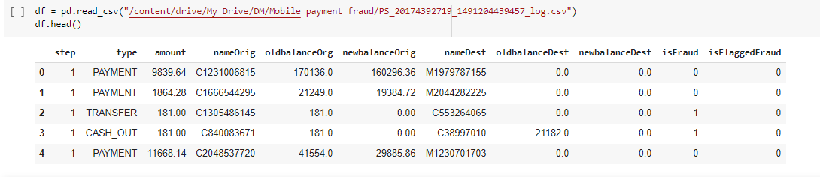
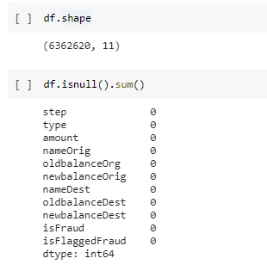
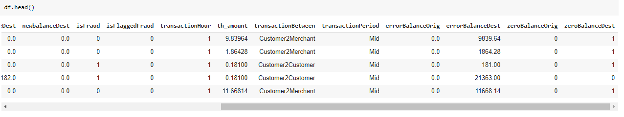

Quick look at the dataset
Derived features like ‘balance post transactions’, ‘zero balance’ flag

Slide 5
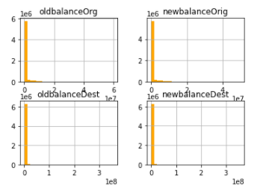
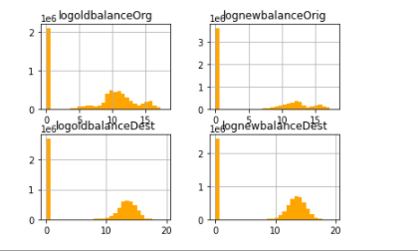
Quick look at the dataset
Outliers= cannot delete as can be fraud transactions.
Log-transform of the data

Slide 6
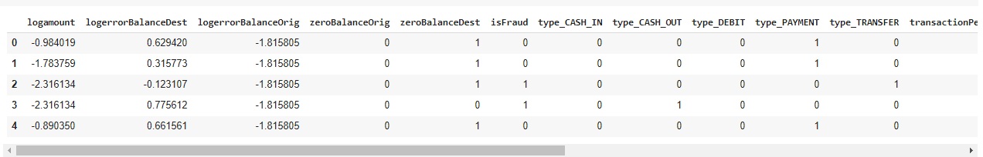
Quick look at the dataset
Missing values=No missing values
Standardization-numerical variables
One hot-encoding –categorical variables

Slide 7
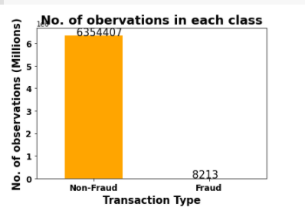
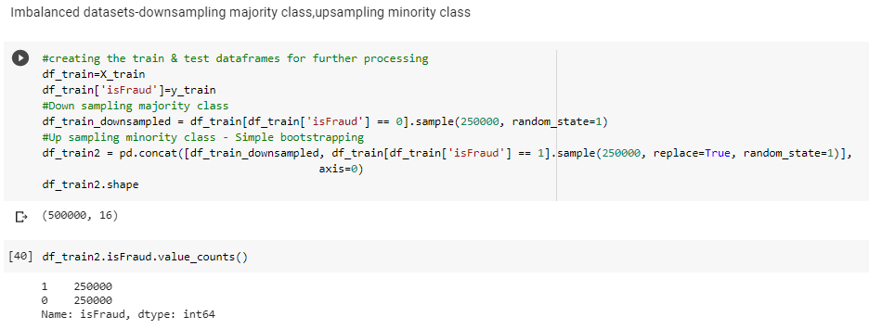

Quick look at the dataset
Class Imbalance-
(6354407,8213)
Over-sampling – Minority class via bootstrapping
Under-sampling-Majority class

Slide 8
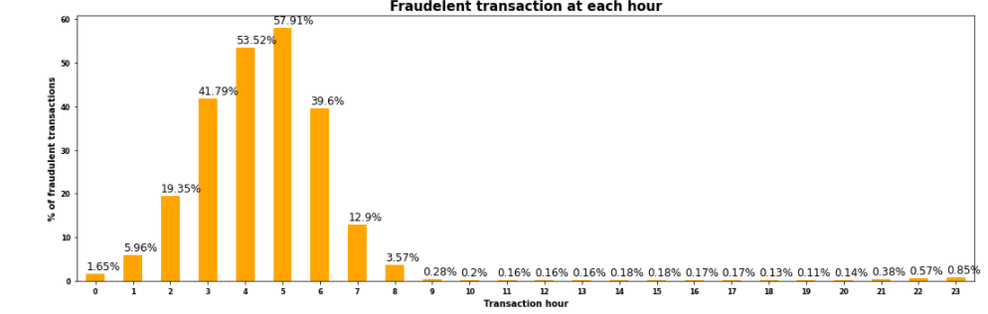
Univariate Analysis Notable findings
Proportion of fraudulent transactions gradually increases from 9:00 pm, peaks at 5:00 am (~58%)
13 Final variables are used basis exploratory data analysis

Slide 9
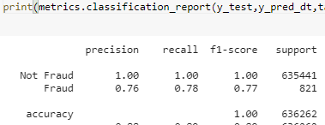
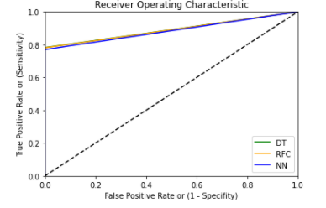
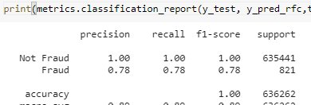
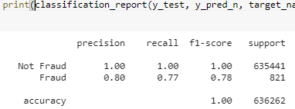
Supervised learning Fraud transactions have a pattern which can be learnt
Decision Tree
Random Forest
Neural Networks

Slide 10
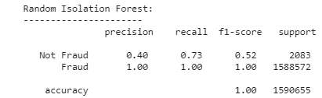
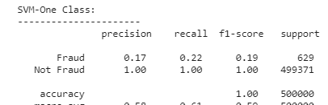
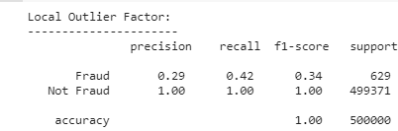
Outlier Detection Fraud transactions are outliers among the normal transactions
Isolation Forest
SVM-one class
Local
Outlier factor

Slide 11
Conclusion
Notable findings-
Outlier detection methods (isolation forest) fits better
However, late night transactions should have slightly high weight towards ‘fraud’
Challenges to counter-
Better precision/recall values
We need high precision- to ensure we don’t block right transactions, as it will lead to financial loss
Recall- we need to ensure we cover each fraudulent transactions as it will lead to financial/ reputational loss
How to improve the model further
Outlier Detection seems to be a better fit
More Advanced anomaly detection techniques

Slide 12

Thanks!
Any questions?

